Slide 1


In-Depth Analysis & Comparison of Parallelism Techniques in Python & Go
“CS159”
Ziad Mansour Mohamed
016123575

Slide 2

Ziad Mansour Mohamed
Exchange Student @SJSU for Spring 2022
Cairo University, Faculty of Computer Engineering
Originally from Luxor, the old capital 3,400-year-old. Also, known as the World’s Largest Open-air Museum.
Fun Random Facts:
Stargazer 🔭
SREboy.com
SRE: Site Reliability Engineering
This is my first presentation in English ^^
Raise my voice
Repeat any point
Ask about syntax

Slide 3




AGENDA
Concepts
Python
Python Code
Go
Go Code

Slide 4

Interpreted vs Compiled
Python is Slow
Speed and Cost of Development + Technical Dept
The readability of the Language and Learning Curve
“If we rewrote the entire codebase of Instagram in a compiled language like Cpp we will get about only 6% increase in performance, without mentioning all the cons of such a decision like the high cost of Cpp development or its learning curve. While we were able to achieve 45% increase in performance shifting our attention to a more scalable infrastructure.” - [Lisa Guo, Scaling Instagram Infrastructure]
It is all about business at the end of the day 💲💰💵

Slide 5
Sequential
Core One
T1
T2
Core Two
T3
T4

Slide 6
Concurrent
Core One
T1
T2
Core Two
T3
T4

Slide 7
Parallelism
Core One
T1
T2
Core Two
T3
T4

Slide 8
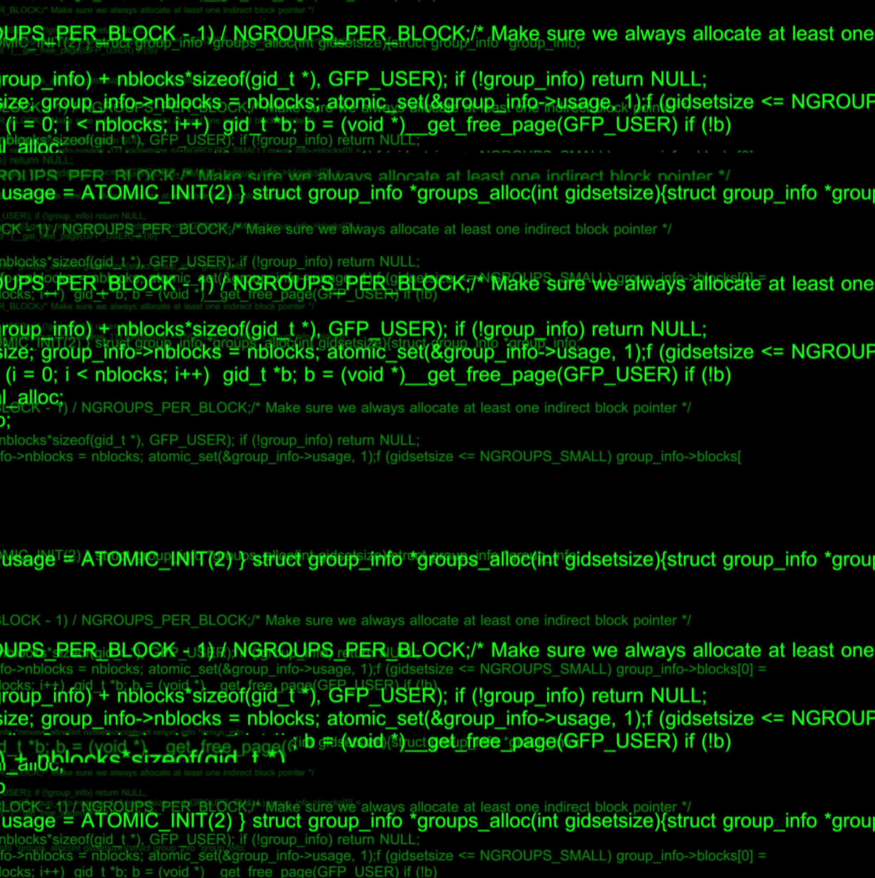
GIL.py

Slide 9
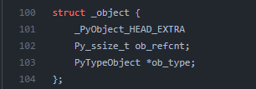
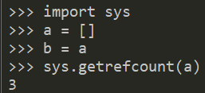
In Python everything is an object:
Python/cpython/include/object.h
Python Object:
Object Type
Ignore: _PyObject_HEAD_EXTRA
Ob_refcnt
Object Reference Counter
When it reaches zero the Object is released
Needs Protection from race conditions:
Memory leakage
Early Release DANGEROUS

Slide 10
Python Global Interpreter Lock 🔒 GIL
The Python Global Interpreter Lock or GIL:
introduced in 1992 to CPython
A mutex (or a lock) that allows only one thread to hold the control of the Python interpreter.
This means that only one thread can be in a state of execution at any point in time.
The other suggested solutions included:
Get red of the GIL and ref_counter and do Garbage Collecting
Jython: Java, IronPython: .NET, PyPy: Jit compiler.
“The design decision of the GIL is one of the things that made Python as popular as it is today. Actually, Indeed part of the reasons Python is successful today because it had the GIL” - [Larry Hastings, Python’s Infamous GIL]

Slide 11
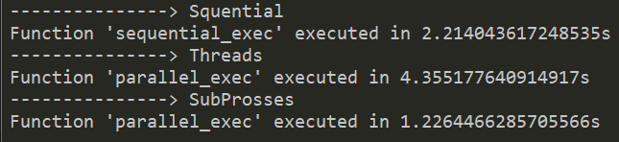
gil.py
CPU bound Counting till 50_000_000
Know we know about the GIL
Single Core
Context Switch
Cost of Spawning threads
Python threads don’t correspond to HW threads "Cpython“
Python runtime not OS schedular
Context Switch every 100 Byte Code

Slide 12
multiprocessing.py

Slide 13
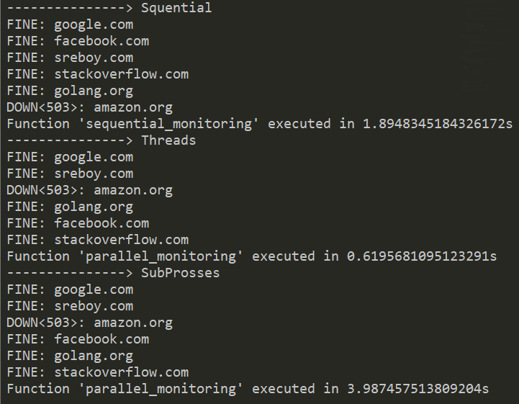
multiprocessing.py
I/O bound Status Checker Program
multiprocessing.pool
Pool as ProcessPool
ThreadPool
multiprocessing Python pkg “SubProsses"
Child processes started by Python
Interpreter => GIL
CPU Bound
CONS:
Spawning processes is a bit slower than threads
Creating Pools has a certain amount of overhead

Slide 14
map.py

Slide 15
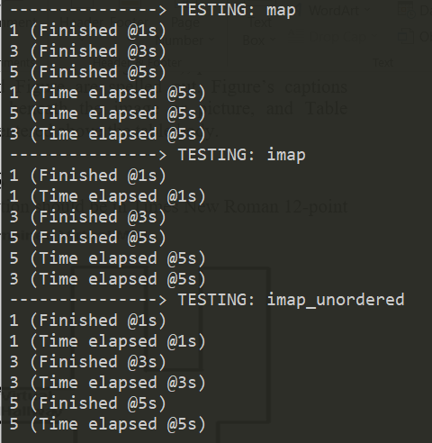
map.py
"map, map_async" && "imap, imap_unordered".
map
Iterable > list > Break it into Chunks
send chunks to workers processes in the pool
PROS:
Huge Performance Increase than looping over the iterable itself and passing each item between processes one at a time.
CONS: High memory Usage
You won’t be able to see the results until all processes are finished.

Slide 16
map.py
imap
Will not cut it into chunks, unless chunksize
send chunks to workers processes in the pool
PROS:
less memory usage
CONS: lower performance
Results are yielded as soon as they are finished. Notice: imap keeps order.
imap_unordered
Same as imap but It doesn’t keep order
To be specific randomly, not first finish first yield

Slide 17

Sequential/main.go

Slide 18
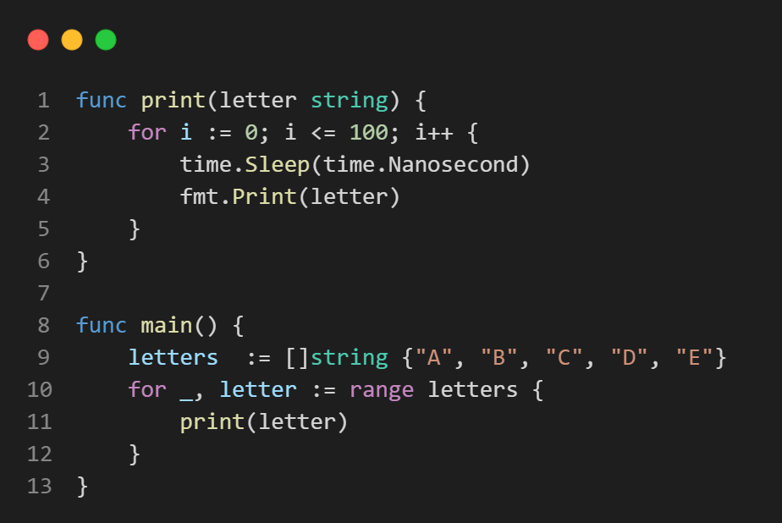
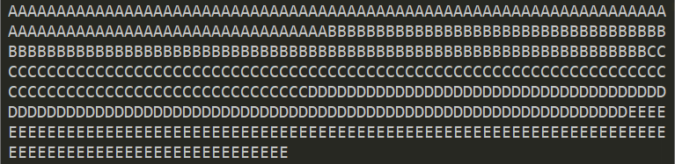

Sequential/main.go
MainRoutine: Go process created when you executed Go code.
Single Core

Slide 19
ConcurrentOne/main.go

Slide 20
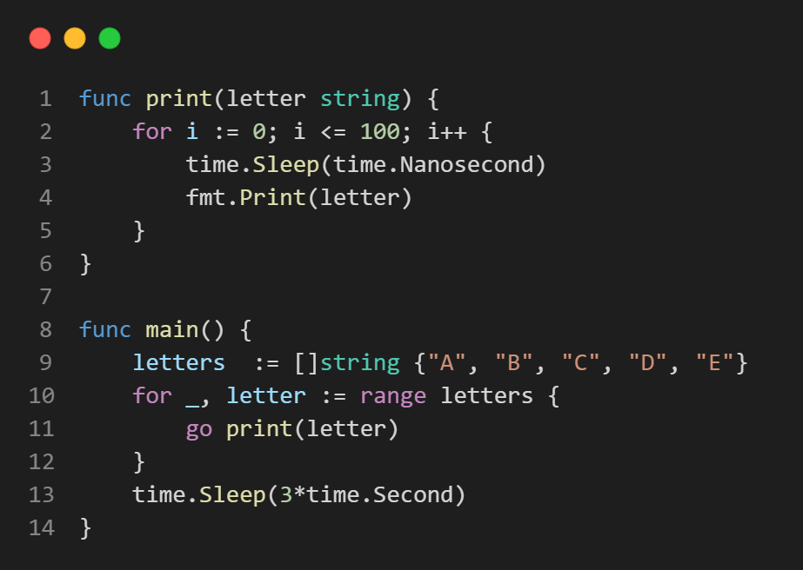
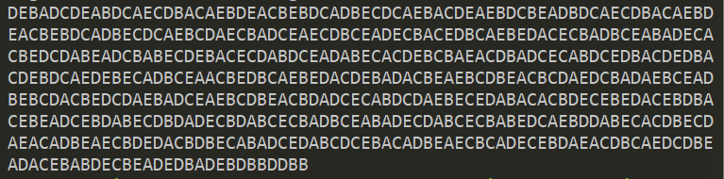

ConcurrentOne/main.go
go keyword: run this function in a separate GoRoutine.
Goroutines don’t correspond to OS threads
Threads initial size: 1000 to 2000 KB
GoRoutines initial size: 2 KB
Thousands even millions of GoRoutines
Go Schedular
Will spin and continue running the first go routine inside the main routine until:
The Goroutine finishes executing
The routine gets blocked waiting on I/O
It will spin the next GoRoutine

Slide 21

ConcurrentTwo/main.go

Slide 22
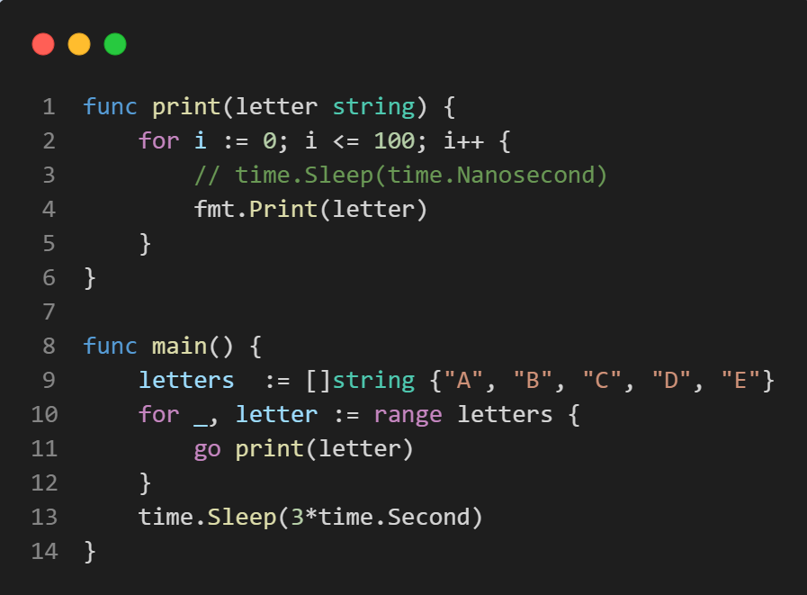
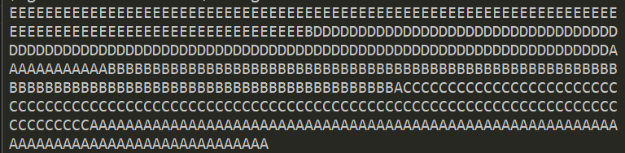

ConcurrentTwo/main.go
Go Schedular
Will spin and continue running the first go routine inside the main routine until:
The Goroutine finishes executing
The routine gets blocked waiting on I/O
It will spin the next GoRoutine

Slide 23
ConcurrentThree/main.go

Slide 24
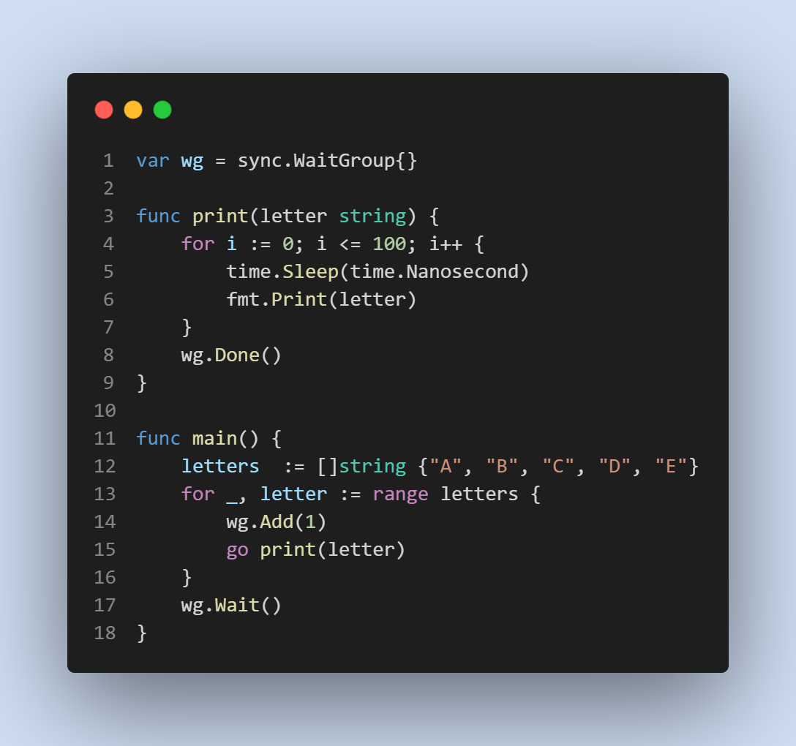
ConcurrentThree/main.go
sync.WaitGroup
Add, Done, Wait
Used in Synchronizing GoRoutines
If the MainRoutine exits, all the child routines are killed 😨

Slide 25

Channels/main.go

Slide 26
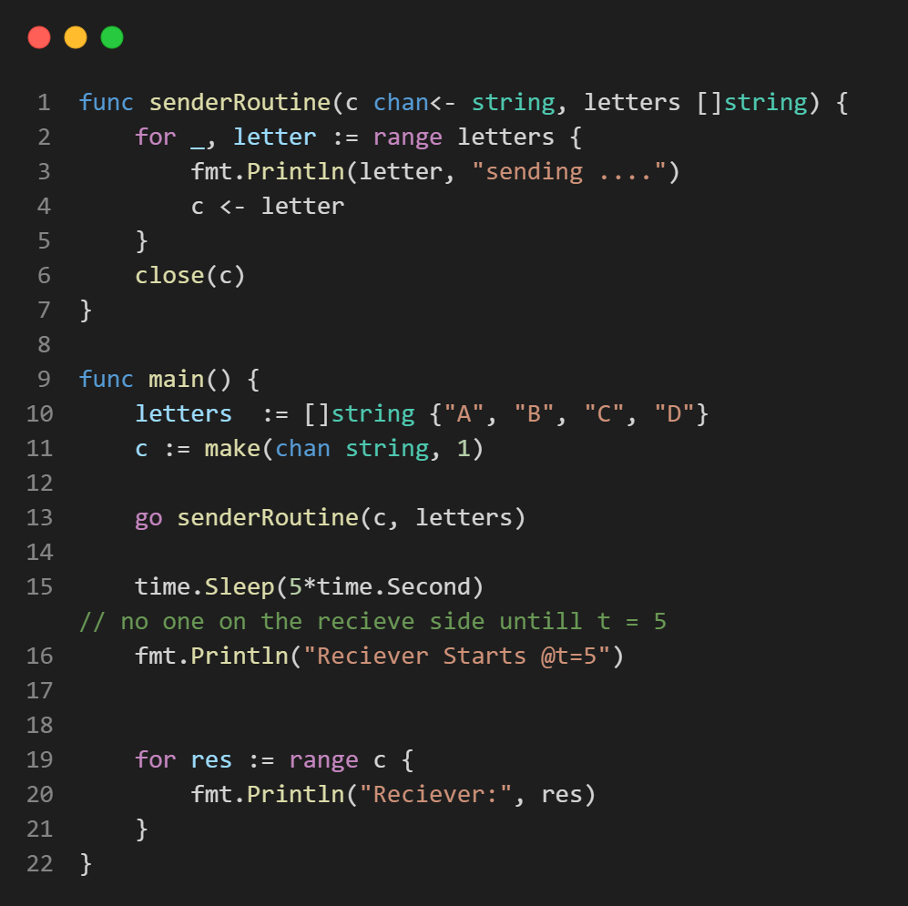
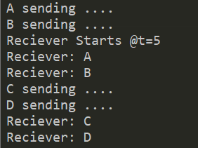
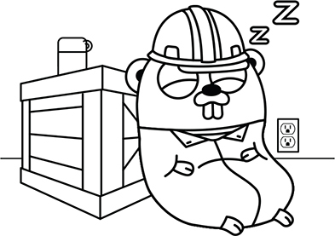
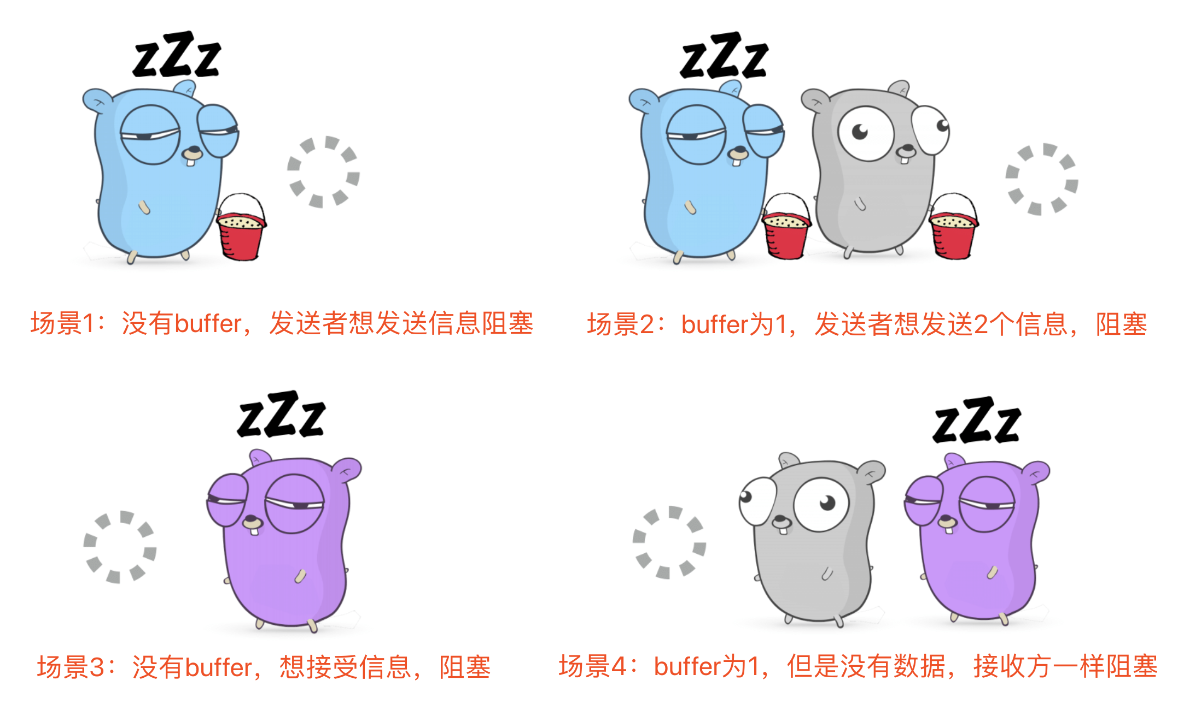
Channels /main.go
"Don't communicate by sharing memory; share memory by communicating“ – Go docs
Don't overengineer ITC by "shared memory, complicated, error-prone synchronization primitives. But, instead use message-passing between goroutines (green threads).
Simple Queue. Channels are a simple message passing pattern.
int || complicated data structure. Give away ownership by sending the value or a pointer to a different goroutine via a channel.
There is no shared space, each goroutine only sees the portion of memory it owns.

Slide 27


Select/main.go

Slide 28
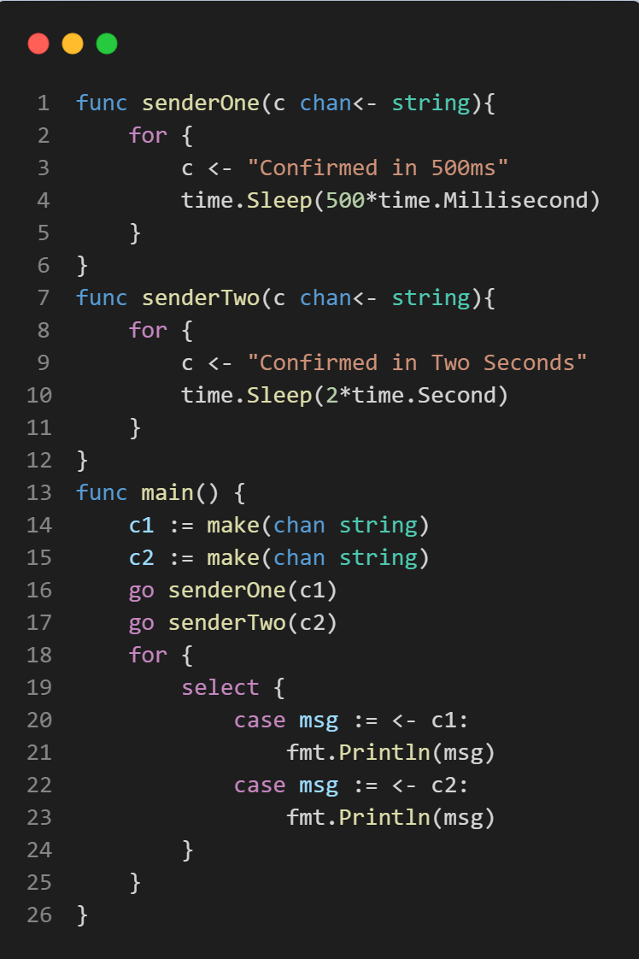
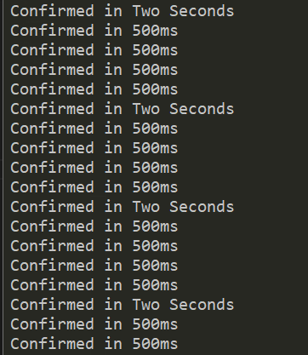

Select/main.go
Receiving / Sending is blocking.
What if you have two channels with different frequencies

Slide 29
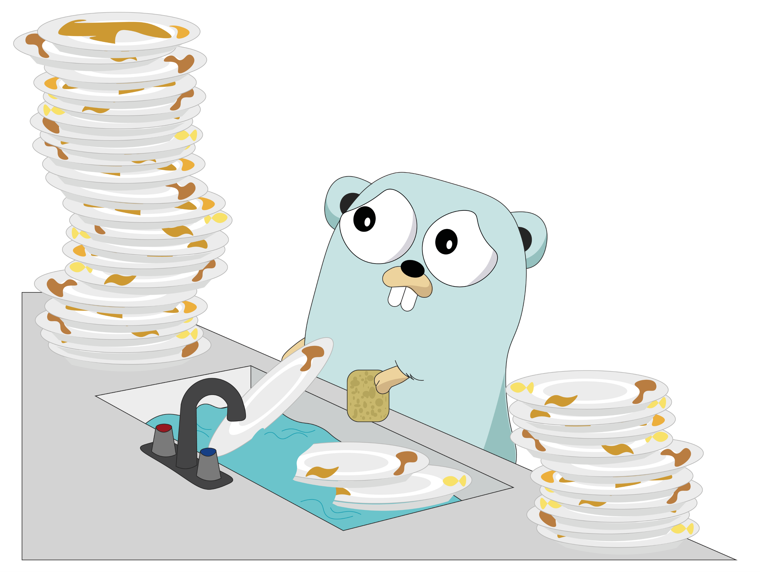


WorkerPoolPattern/main.go

Slide 30
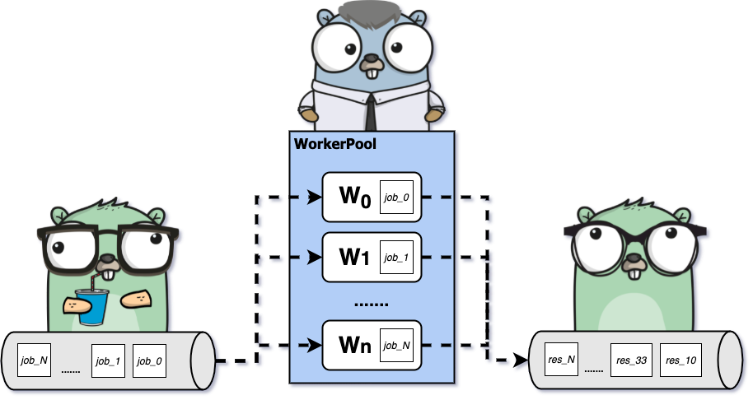
Worker Pool Pattern

Slide 31



SCAN ME

